Slide 1
Artificial neural network based Self-taught leaning on text mining
Lecture 14 -
1
Fei-Fei Li & Justin Johnson & Serena Yeung Lecture 14 - May 23, 2017

Slide 2
Contents
Introduction(what is self-taught learning)
Related work
Fine-tuning & Multitask Learning
Domain-adversarial training & Zero-shot Learning
Self-taught learning & Self-taught clustering
Self-taught learning
Architecture
Workflow
Text mining representation
Convolutional Neural Network for text
Datasets
Results
Lecture 14 -
2

Slide 3
Introduction
What is Self-taught Learning?
Self-taught Learning is one kind of Transfer learning
Lecture 14 -
3

Slide 4
Introduction
What is Self-taught Learning?
Self-taught Learning is one kind of Transfer learning
Self-taught Learning assume:
The unlabeled data follows the same class labels or generative distribution as the labeled data
Lecture 14 -
4

Slide 5
Introduction
What is Self-taught Learning?
Self-taught Learning is one kind of Transfer learning
Self-taught Learning assume:
The unlabeled data follows the same class labels or generative distribution as the labeled data
Self-taught Learning use:
Large number of unlabeled text randomly downloaded from the Internet to improve performance on a given text classification task.
Lecture 14 -
5

Slide 6
Introduction
Related work:
 | Source Data (Not directly related to task)
Target Data |  | Labelled | Unlabeled
 | Labelled | Fine-tuning
 | Unlabeled
Lecture 14 -
6

Slide 7
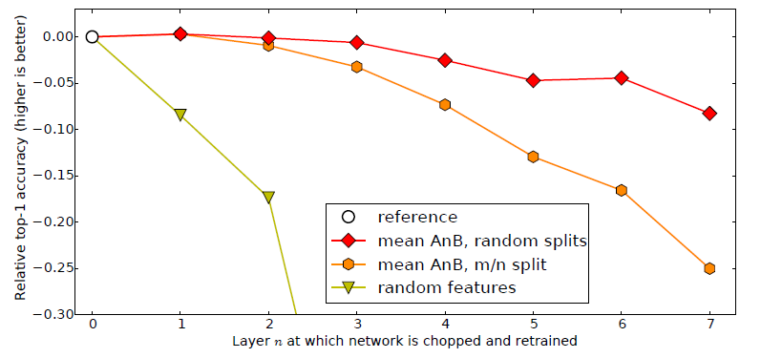
Introduction
Related work: Fine-tuning example
Only train the rest layers
Jason Yosinski,Jeff Clune,Yoshua Bengio,HodLipson, “How transferable are features in deep neural networks?”, NIPS, 2014
Lecture 14 -
7

Slide 8
Introduction
Related work:
 | Source Data (Not directly related to task)
Target Data |  | Labelled | Unlabeled
 | Labelled | Fine-tuning Multitask Learning
 | Unlabeled
Lecture 14 -
8

Slide 9
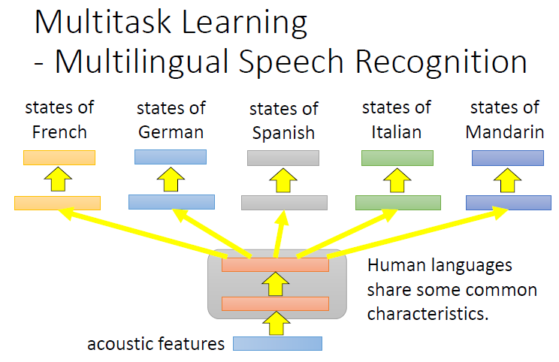
Introduction
Related work: Multi-task Learning
Daxiang Dong, HuaWu, Wei He, Dianhai Yu and Haifeng Wang, “Multi-Task Learning for Multiple Language Translation - ACL Anthology”, ACL, 2015
Lecture 14 -
9

Slide 10
Introduction
Related work:
 | Source Data (Not directly related to task)
Target Data |  | Labelled | Unlabeled
 | Labelled | Fine-tuning Multitask Learning
 | Unlabeled | Domain-adversarial training
Lecture 14 -
10

Slide 11
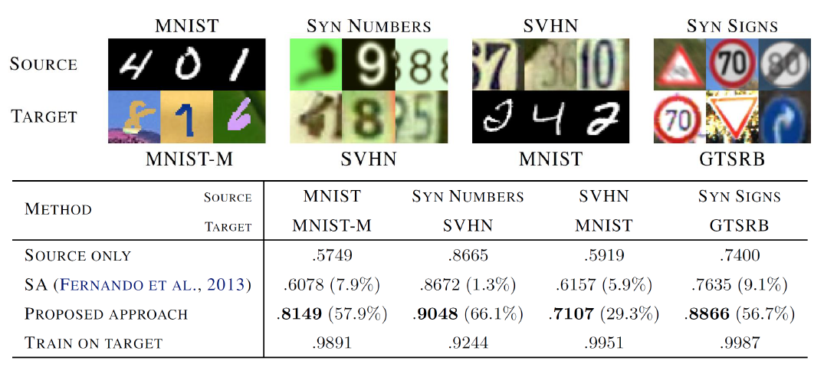
Introduction
Related work: Domain adversarial training
Yaroslav Ganin, Victor Lempitsky, Unsupervised Domain Adaptation by Backpropagation, ICML, 2015
Hana Ajakan, Pascal Germain, Hugo Larochelle, François Laviolette, Mario Marchand,
Domain-Adversarial Training of Neural Networks, JMLR, 2016
Lecture 14 -
11

Slide 12
Introduction
Related work:
 | Source Data (Not directly related to task)
Target Data |  | Labelled | Unlabeled
 | Labelled | Fine-tuning Multitask Learning
 | Unlabeled | Domain-adversarial training Zero-shot Learning
Lecture 14 -
12

Slide 13
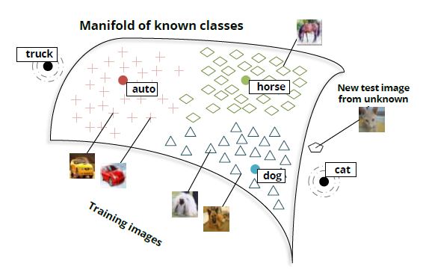
Introduction
Related work: Zero-shot Learning
Richard Socher, Milind Ganjoo, Christopher D. Manning, Andrew Y. Ng, “Zero-Shot Learning Through Cross-Modal Transfer” NIPS,2013
Lecture 14 -
13

Slide 14
Introduction
Related work:
 | Source Data (Not directly related to task)
Target Data |  | Labelled | Unlabeled
 | Labelled | Fine-tuning Multitask Learning | Self-taught learning
 | Unlabeled | Domain-adversarial training Zero-shot Learning
Lecture 14 -
14

Slide 15
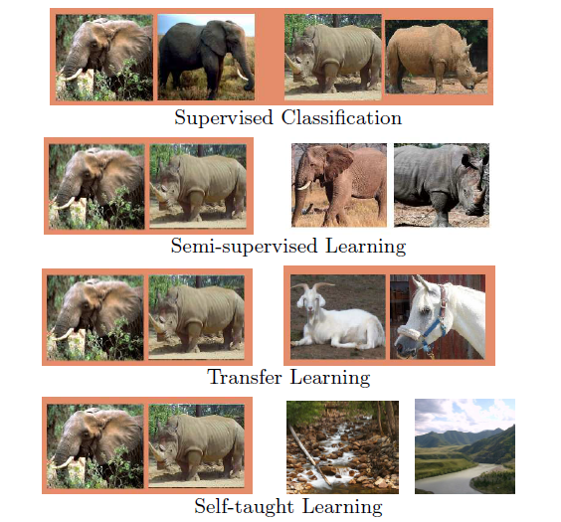
Introduction
Related work: Self-taught Learning
Rajat Raina, Alexis Battle, Honglak Lee, Benjamin Packer, Andrew Y. Ng,"Self-taught Learning: Transfer Learning from Unlabeled Data", ICML,2007
Lecture 14 -
15

Slide 16
Introduction
Related work:
 | Source Data (Not directly related to task)
Target Data |  | Labelled | Unlabeled
 | Labelled | Fine-tuning Multitask Learning | Self-taught learning
 | Unlabeled | Domain-adversarial training Zero-shot Learning | Self-taught clustering
Lecture 14 -
16

Slide 17
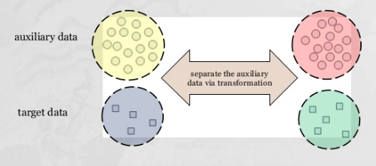
Introduction
Related work: Self-taught Clustering
Wenyuan Dai, Qiang Yang, Gui-Rong Xue, Yong Yu, “Self-taught Clustering ”, ICML,2008
Lecture 14 -
17

Slide 18
Introduction
Related work:
 | Source Data (Not directly related to task)
Target Data |  | Labelled | Unlabeled
 | Labelled | Fine-tuning Multitask Learning | Self-taught learning
 | Unlabeled | Domain-adversarial training Zero-shot Learning | Self-taught clustering
Lecture 14 -
18

Slide 19
Word2Vector
How do we representing meaning of word
Definition: Meaning (Webster dictionary)
the idea that is represented by a word, phrase, etc.
the idea that a person wants to express by using words, signs, etc.
the idea that is expressed in a work of writing, art, etc.
Lecture 14 -
19

Slide 20
Word2Vector
Problems with discrete representation
Great as resource but missing nuances, e.g. synonyms: adept, expert, good, practiced, proficient, skillful?
Missing new words (impossible to keep up to date): wicked, badass, nifty, crack, ace, wizard, genius, ninjia
Subjective
Requires human labor to create and adapt
Hard to compute accurate word similarity
Lecture 14 -
20

Slide 21
Word2Vector
Problems with discrete representation
The vast majority of rule-based and statistical NLP work regards
words as atomic symbols
In vector space terms, this is a vector with one 1 and a lot of zeroes
[0 0 0 0 0 0 0 0 0 0 1 0 0 0 0]
Lecture 14 -
21

Slide 22
Word2Vector
Main Idea of word2vec
• Instead of capturing cooccurrence counts directly
• Predict surrounding words of every word
• Faster and can easily incorporate a new sentence document or add a word to the vocabulary
Lecture 14 -
22

Slide 23
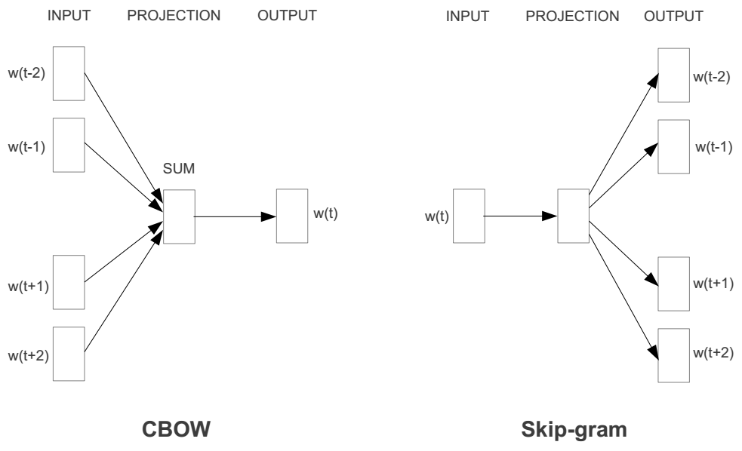
Word2Vector
Basic neural network models:
Continuous Bag of Word (CBOW): use a window of word to predict the middle word
Skip-gram (SG): use a word to predict the surrounding ones in window.
Lecture 14 -
23

Slide 24
Word2Vector
word2vec model:
1 Given a specific word “fox”
The quick brown fox jumps over the lazy dog
24

Slide 25
Word2Vector
word2vec model:
1 Given a specific word “fox”
2 Define nearby word by window size
The quick brown fox jumps over the lazy dog
25

Slide 26
Word2Vector
word2vec model:
1 Given a specific word “fox”
2 Define nearby word by window size
Window size = 1
The quick brown fox jumps over the lazy dog
26

Slide 27
Word2Vector
word2vec model:
1 Given a specific word “fox”
2 Define nearby word by window size
The quick brown fox jumps over the lazy dog
Window size = 2
27

Slide 28
Word2Vector
word2vec model:
1 Given a specific word “fox”
2 Define nearby word by window size
Window size = 1
The quick brown fox jumps over the lazy dog
Window size = 2
28

Slide 29
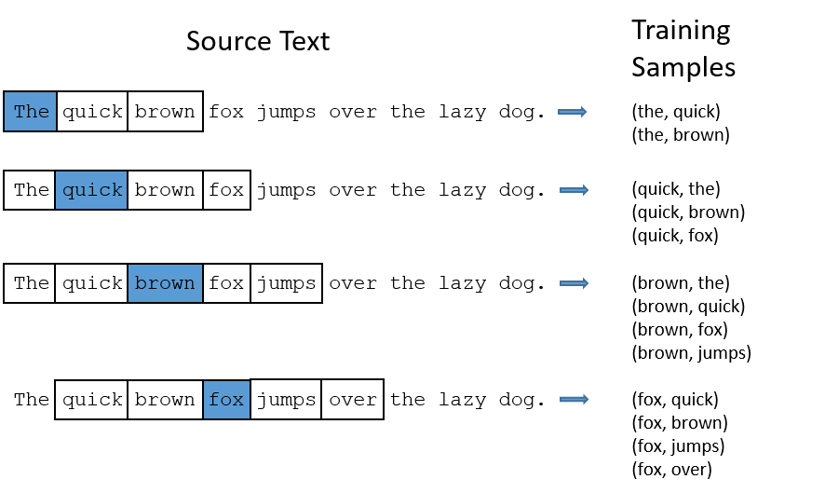
Word2Vector
word2vec model:
29

Slide 30
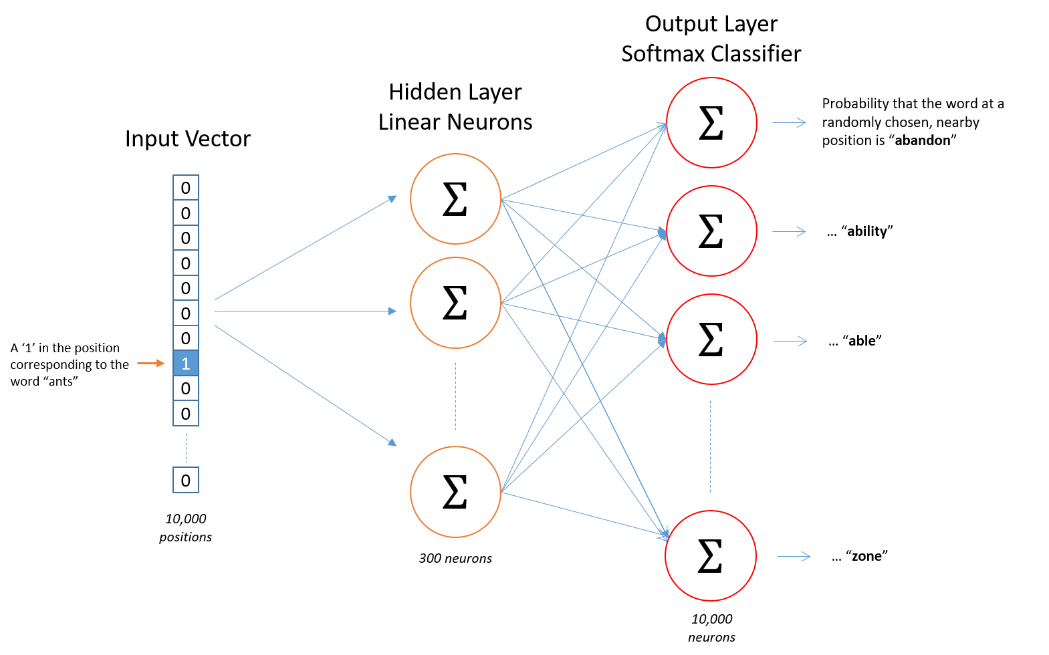
Word2Vector
word2vec model:
30

Slide 31
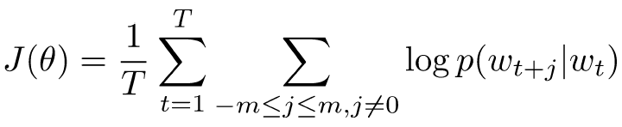
Word2Vector
Details of Word2vec
Predict surrounding words in a window of length m of every word.
Objective function: Maximize the log probability of any context word given the current center word:
Where represents all variables we optimize
31

Slide 32
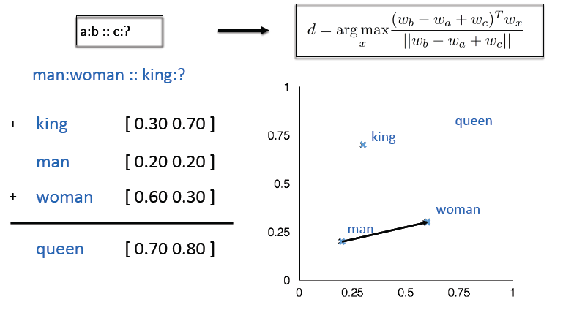
Word2Vector
Word Analogies
Test for linear rela4onships, examined by Mikolov et al. (2014)

Slide 33
CNN for text classification
CNN(Convolutional neural network) Model

Slide 34
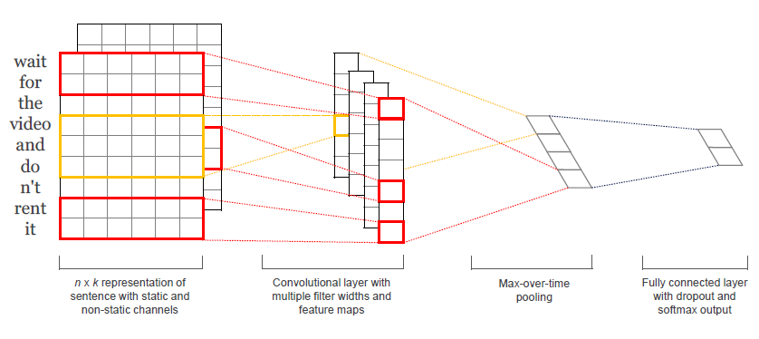
CNN for text classification
The Model
Kim, Y. (2014). Convolutional Neural Networks for Sentence Classification. EMNLP 2014

Slide 35
CNN for text classification
Steps:
First layers embeds words into low-dimensional vectors.
Next layer performs convolutions over the embedded word vectors using multiple filter sizes. For example, sliding over 3, 4 or 5 words at a time.
Max-pool the result of the convolutional layer into a long feature vector
Add dropout regularization, and classify the result using a softmax layer.

Slide 36
Datasets-Labelled data
Datasets | Data for classification |  | Total
News Datasets | Business | 502 | 2,098
 | Entertainment | 364
 | Politics | 399
 | Sports | 497
 | Tech | 336
Movie Review Datasets(From Cornell) | Negative | 5,331 | 10,662
 | Positive | 5,331
Large Movie review datasets(From Stanford) | Negative | 4,500 | 9,000
 | Positive | 4,500
Amazon food review Datasets | Negative | 5,000 | 10,000
 | Positive | 5,000

Slide 37
Datasets-Unlabeled data
Datasets | Datasets for unsupervised learning |  | Total
News Datasets | Business | 5,444 | 28,726
 | Entertainment | 4,011
 | Politics | 5,188
 | Sports | 6,138
 | Tech | 7,945
Movie Review Datasets(From Cornell) | Negative | 12,500 | 25,000
 | Positive | 12,500
Large Movie review datasets(From Stanford) | Negative | 12,500 | 25,000
 | Positive | 12,500
Amazon food review Datasets | Negative | 30,000 | 60,000
 | Positive | 30,000

Slide 38
Datasets
Datasets | Data for classification |  | Total | Datasets for unsupervised learning |  | Total
News Datasets | Business | 502 | 2,098 | Business | 5,444 | 28,726
 | Entertainment | 364 |  | Entertainment | 4,011
 | Politics | 399 |  | Politics | 5,188
 | Sports | 497 |  | Sports | 6,138
 | Tech | 336 |  | Tech | 7,945
Movie Review Datasets(From Cornell) | Negative | 5,331 | 10,662 | Negative | 12,500 | 25,000
 | Positive | 5,331 |  | Positive | 12,500
Large Movie review datasets(From Stanford) | Negative | 4,500 | 9,000 | Negative | 12,500 | 25,000
 | Positive | 4,500 |  | Positive | 12,500
Amazon food review Datasets | Negative | 5,000 | 10,000 | Negative | 30,000 | 60,000
 | Positive | 5,000 |  | Positive | 30,000

Slide 39
Working flow-Without transfer
Inputs are documents
Labelled Dataset
Document
Preprocessing
Word2Vec
Model
Removing noise (url, etc.)
Lowercasing
Tokenization (optional)

Slide 40
Working flow-Without transfer
Outputs are vectors for
each word
Inputs are documents
Labelled Dataset
Word
Embedding
Document
Preprocessing
Word2Vec
Model
Removing noise (url, etc.)
Lowercasing
Tokenization (optional)

Slide 41

Working flow-Without transfer
Outputs are vectors for
each word
Inputs are documents
Labelled Dataset
Word
Embedding
Document
Preprocessing
Word2Vec
Model
Removing noise (url, etc.)
Lowercasing
Tokenization (optional)
CNN
Classifier

Slide 42
Working flow-Without transfer
Outputs are vectors for
each word
Inputs are documents
Labelled Dataset
Word
Embedding
Document
Preprocessing
Word2Vec
Model
Removing noise (url, etc.)
Lowercasing
Tokenization (optional)
Classify Result
CNN
Classifier

Slide 43
Working flow-Transfer from unlabeled data
Labelled Dataset
Document
Preprocessing
Unlabeled Dataset
Removing noise (url, etc.)
Lowercasing
Tokenization (optional)

Slide 44
Working flow-Transfer from unlabeled data
Outputs are vectors for
each word
Inputs are documents
Labelled Dataset
Word
Embedding
Document
Preprocessing
Word2Vec
Model
Unlabeled Dataset
Removing noise (url, etc.)
Lowercasing
Tokenization (optional)

Slide 45
Working flow-Transfer from unlabeled data
Outputs are vectors for
each word
Inputs are documents
Labelled Dataset
Word
Embedding
Document
Preprocessing
Word2Vec
Model
Unlabeled Dataset
Removing noise (url, etc.)
Lowercasing
Tokenization (optional)
CNN
Classifier

Slide 46
Working flow-Transfer from unlabeled data
Outputs are vectors for
each word
Inputs are documents
Labelled Dataset
Word
Embedding
Document
Preprocessing
Word2Vec
Model
Unlabeled Dataset
Removing noise (url, etc.)
Lowercasing
Tokenization (optional)
Classify Result
CNN
Classifier

Slide 47
Result
Large newsdata improve BBC newsdata classification
Datasets | Data for classification |  | Total | Datasets for unsupervised learning |  | Total
News Datasets | Business | 502 | 2,098 | Business | 5,444 | 28,726
 | Entertainment | 364 |  | Entertainment | 4,011
 | Politics | 399 |  | Politics | 5,188
 | Sports | 497 |  | Sports | 6,138
 | Tech | 336 |  | Tech | 7,945
47

Slide 48
Results
Large newsdata improve BBC newsdata classification
Learn from 28,726 large news data
Word2vec
model
2098 bbc
News data
Word2vec
model
28,726
Large newsdata
Words in vectors
Words in vectors
CNN Model
CNN Model
Trained classifier A
Trained classifier B
48

Slide 49
Results
Large newsdata improve BBC newsdata classification
Learn from 28,726 large news data
Word2vec
model
2098 bbc
News data
Word2vec
model
28,726
Large newsdata
Accuracy on
labelled data
Accuracy on
unlabeled data
(has label, but was treated as unlabeled)
Before
Transfer 0.947 0.573
(classifier A)
Words in vectors
Words in vectors
CNN Model
CNN Model
Trained classifier A
Trained classifier B
49

Slide 50
Results
Large newsdata improve BBC newsdata classification
Learn from 28,726 large news data
Word2vec
model
2098 bbc
News data
Word2vec
model
28,726
Large newsdata
Accuracy on
labelled data
Accuracy on
unlabeled data
(has label, but was treated as unlabeled)
Before
Transfer 0.947 0.573
(classifier A)
Words in vectors
Words in vectors
CNN Model
CNN Model
After
Transfer 0.971 0.752
(classifier B)
Trained classifier A
Trained classifier B
50

Slide 51
Result
Large movie review data improve small movie review data
Datasets | Data for classification |  | Total | Datasets for unsupervised learning |  | Total
Movie Review Datasets(From Cornell) | Negative | 5,331 | 10,662 | Negative | 12,500 | 25,000
 | Positive | 5,331 |  | Positive | 12,500
51

Slide 52
Results
Large movie review data improve Small movie review data
Learn from 25,000 movie review data
Word2vec
model
10,662 movie review data
Word2vec
model
25,000
Movie review data
Accuracy on
labelled data
Accuracy on
unlabeled data
(has label, but was treated as unlabeled)
Before
Transfer 0.718 0.622
(classifier A)
Words in vectors
Words in vectors
CNN Model
CNN Model
Trained classifier A
Trained classifier B
52

Slide 53
Results
Large movie review data improve Small movie review data
Learn from 25,000 movie review data
Word2vec
model
10,662 movie review data
Word2vec
model
25,000
Movie review data
Accuracy on
labelled data
Accuracy on
unlabeled data
(has label, but was treated as unlabeled)
Before
Transfer 0.718 0.622
(classifier A)
Words in vectors
Words in vectors
CNN Model
CNN Model
After
Transfer 0.764 0.656
(classifier B)
Trained classifier A
Trained classifier B
53

Slide 54
Result
Movie review data B improve Movie review data A
Datasets | Data for classification |  | Total | Datasets for unsupervised learning |  | Total
Large Movie review datasets(From Stanford) | Negative | 4,500 | 9,000 | Negative | 12,500 | 25,000
 | Positive | 4,500 |  | Positive | 12,500
54

Slide 55
Results
Movie review data B improve Movie review data A
Learn from 25,000 movie review data B
Word2vec
model
9000
movie review data
Word2vec
model
25,000
Movie review data
Accuracy on
labelled data
Accuracy on
unlabeled data
(has label, but was treated as unlabeled)
Before
Transfer 0.832 0.811
(classifier A)
Words in vectors
Words in vectors
CNN Model
CNN Model
Trained classifier A
Trained classifier B
55

Slide 56
Results
Movie review data B improve Movie review data A
Learn from 25,000 movie review data B
Word2vec
model
9000
movie review data
Word2vec
model
25,000
Movie review data
Accuracy on
labelled data
Accuracy on
unlabeled data
(has label, but was treated as unlabeled)
Before
Transfer 0.832 0.811
(classifier A)
Words in vectors
Words in vectors
CNN Model
CNN Model
After
Transfer 0.843 0.833
(classifier B)
Trained classifier A
Trained classifier B
56

Slide 57
Result
Food review data B improve Food review data A
Datasets | Data for classification |  | Total | Datasets for unsupervised learning |  | Total
Amazon food review Datasets | Negative | 5,000 | 10,000 | Negative | 30,000 | 60,000
 | Positive | 5,000 |  | Positive | 30,000
57

Slide 58
Results
Food review data B improve Food review data A
Learn from 60,000 food review data
Word2vec
model
10,000
movie review data
Word2vec
model
60,000
Movie review data
Accuracy on
labelled data
Accuracy on
unlabeled data
(has label, but was treated as unlabeled)
Before
Transfer 0.876 0.823
(classifier A)
Words in vectors
Words in vectors
CNN Model
CNN Model
Trained classifier A
Trained classifier B
58

Slide 59
Results
Food review data B improve Food review data A
Learn from 60,000 food review data
Word2vec
model
10,000
movie review data
Word2vec
model
60,000
Movie review data
Accuracy on
labelled data
Accuracy on
unlabeled data
(has label, but was treated as unlabeled)
Before
Transfer 0.876 0.823
(classifier A)
Words in vectors
Words in vectors
CNN Model
CNN Model
After
Transfer 0.887 0.856
(classifier B)
Trained classifier A
Trained classifier B
59

Slide 60
Result
60

Slide 61
Conclusion
Features learned from unlabeled data enhanced the classification of labelled data

Slide 62
Conclusion
Features learned from unlabeled data enhanced the classification of labelled data
Classifier trained from small volume labelled data is better when using features learned from unlabeled data

Slide 63
Conclusion
Features learned from unlabeled data enhanced the classification of labelled data
Classifier trained from small volume labelled data is better when using features learned from unlabeled data
Trained classifier can be used to assign labels for unlabeled data

Slide 64
Conclusion
Features learned from unlabeled data enhanced the classification of labelled data
Classifier trained from small volume labelled data is better when using features learned from unlabeled data
Trained classifier can be used to assign labels for unlabeled data
Part of unlabeled data has labels, which can be used to train a better classifier.

Slide 65
References
[1] David M Blei, Thomas L Griffiths, and Michael I Jordan. 2010. The nested chinese
restaurant process and bayesian nonparametric inference of topic hierarchies.
Journal of the ACM (JACM) 57, 2 (2010), 7.
[2] DavidMBlei, AndrewY Ng, and Michael I Jordan. 2003. Latent dirichlet allocation.
Journal of Machine Learning Research 3, Jan (2003), 993–1022.
[3] Kevin Robert Canini, Lei Shi, and Thomas L Griffiths. 2009. Online Inference of
Topics with Latent Dirichlet Allocation.. In AISTATS, Vol. 9. 65–72.
[4] Ziqiang Cao, Sujian Li, Yang Liu, Wenjie Li, and Heng Ji. 2015. A Novel Neural
Topic Model and Its Supervised Extension.. In AAAI. 2210–2216.
[5] Rajarshi Das, Manzil Zaheer, and Chris Dyer. 2015. Gaussian lda for topic models
with word embeddings. In ACL Meeting. 795–804.
[6] Scott Deerwester, Susan T Dumais, George W Furnas, Thomas K Landauer, and
Richard Harshman. 1990. Indexing by latent semantic analysis. Journal of the
American Society for Information Science 41, 6 (1990), 391.
[7] Jacob Eisenstein, Amr Ahmed, and Eric P Xing. 2011. Sparse additive generative
models of text. In ICML
Lecture 14 -
65

